Slide 1
Text Pre-Processing and Data Preparation
Transforming Raw Data into NLP Ready Data

Slide 2
Contents
01
02
Text Cleaning
Case Standardization
03
04
Tokenization
Stop Word Removal
05
06
Normalization
Advanced Steps

Slide 3
Text Preprocessing for NLP
Before feeding raw text into any NLP model, it must be cleaned and structured. Raw text is noisy, inconsistent, and unstructured — preprocessing transforms it into a standardized format that machine learning algorithms can understand.
The Core Problem
The Solution
Task Dependency
Raw text is messy: inconsistent casing, HTML artifacts, slang, and inflected forms all confuse models.
A structured preprocessing pipeline transforms noise into clean, model-ready input.
There is no universal pipeline. The steps you choose depend entirely on your downstream NLP task.

Slide 4
The Standard NLP Preprocessing Pipeline
A typical pipeline follows six stages — each serving a specific purpose in transforming raw text into structured input.
01
02
Text Cleaning
Case Normalization
Remove HTML, URLs, special characters, and noise.
Lowercase everything to unify surface forms.
03
04
Tokenization
Stop Word Removal
Break text into sentences and individual tokens.
Discard low-information function words.
05
06
Normalization
Advanced Steps
Reduce words to their base or root form.
POS tagging, contraction expansion, spelling correction.

Slide 5
STEP 1
Text Cleaning — Noise Removal
The first step strips out elements that add no semantic value or actively mislead the model. What you remove depends on your task.
HTML Tags & URLs
Special Characters & Punctuation
Emojis & Emoticons
Essential for web-scraped data. Converts <div>Hello</div> → Hello. Raw markup is meaningless to a model.
Remove entirely, or map to descriptors. Example: ❤️ → [love]. The right choice depends on whether sentiment matters.
Remove symbols like @ # $ ! , . — unless punctuation carries meaning (e.g., ! in sentiment analysis).

Slide 6

STEP 2
Case Standardization — Lowercasing
The Problem
The Solution
Computers treat Machine, machine, and MACHINE as three entirely different vocabulary items — inflating the model's vocabulary unnecessarily.
Lowercasing standardizes all surface forms into one, reducing sparsity and improving generalization.
⚠️ Exception — Named Entity Recognition (NER): Uppercase is a critical cue. "Apple" (company) vs. "apple" (fruit) — lowercasing destroys this distinction. Skip this step for NER tasks.

Slide 7

STEP 3
Segmentation & Tokenization
Tokenization breaks a continuous string of text into discrete, manageable units that the model can process individually.
Sentence Segmentation
Word Tokenization
Splits a large paragraph into individual sentences. The foundational unit for many NLP tasks.
Breaks each sentence into individual tokens (words, punctuation).
Example:
"NLP is fun!"
→ ["NLP", "is", "fun", "!"]
Tokenization is the bridge between raw text and numerical representations. Every downstream step — stop word removal, stemming, embeddings — operates on tokens.

Slide 8

STEP 4
Stop Word Removal
What Are Stop Words?
When to Skip This Step:
If your task depends on sentence structure or syntax — such as language modeling or machine translation — stop word removal destroys the grammatical relationships the model needs to learn. Keep them.
High-frequency function words — the, is, and, in, at — that act as grammatical glue but carry very little unique semantic content.
Why Remove Them?
Drastically reduces dataset size and processing cost
Forces the model to focus on content-heavy keywords: nouns, verbs, adjectives
Best For: Text classification, topic modeling, keyword extraction, and search indexing — tasks where keywords dominate over structure.

Slide 9
STEP 5
Text Normalization — The Core Concept
Words appear in many inflected forms: run, running, ran. Without normalization, the model treats these as entirely separate vocabulary items — wasting capacity and reducing generalization.
Normalization maps all inflected variants of a word back to a single canonical form, reducing vocabulary size and helping the model recognize that related word forms carry related meaning.
Two strategies exist, trading off speed and simplicity against linguistic accuracy. Choose based on your task requirements.

Slide 10
STEP 5A
Stemming vs. Lemmatization
Stemming
Lemmatization
A fast, rule-based heuristic that chops off word endings. Does not consult a dictionary — may produce non-words.
Example:
studies, studying, studied → studi
✅ Fast ✅ Simple ❌ Produces non-words
A linguistically accurate approach that looks up the dictionary root (lemma), using Part-of-Speech context.
Example:
studies, studying, studied → study
better → good
✅ Accurate ✅ Real words ❌ Slower
Use stemming when speed matters most. Use lemmatization when linguistic precision is required — especially for smaller, high-quality corpora.

Slide 11
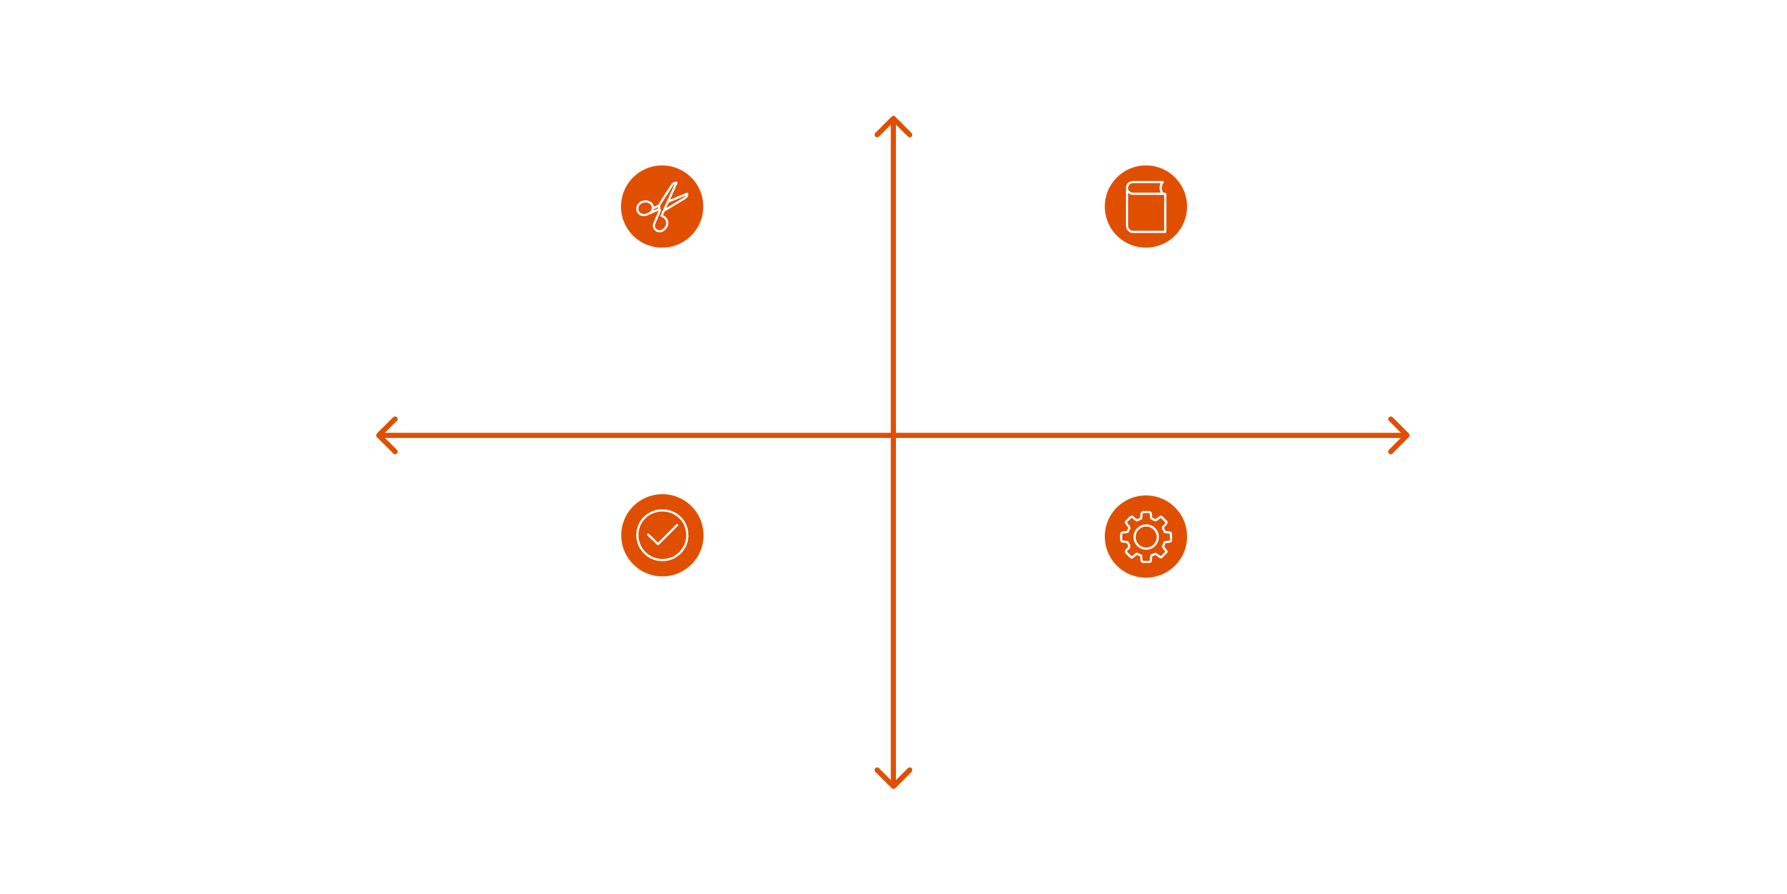

Stemming vs. Lemmatization — Deep Dive
Understanding when to use each requires knowing how they differ under the hood.
High Accuracy
Stemming — Fast rule-based chopping
Lemmatization — Slow dictionary with POS
Low Complexity
High Complexity
Lemmatization Output — Real-word lemmas
Stemming Output — Non-dictionary stems
Low Accuracy
When accuracy matters more than speed — especially in production systems with small, curated datasets — lemmatization is the stronger choice. For large-scale, latency-sensitive pipelines, stemming remains a pragmatic option.

Slide 12
STEP 6
Advanced & Task-Specific Steps
Depending on your downstream architecture and task, additional preprocessing steps may be necessary.
Contraction Expansion
POS Tagging
Spelling Correction
Convert don't → do not, I'm → I am. Ensures consistent token forms across the corpus.
Labels each token as noun, verb, or adjective. Gives the model structural context beyond raw word identity.
Fixes typos before tokenization. Critical for noisy social media or user-generated text where errors are frequent.

Slide 13
Task-Driven Pipeline Design
No single pipeline fits all tasks. Use this reference to decide which steps to apply — and which to skip.
Step
Sentiment Analysis
Machine Translation
Topic Modeling
NER
Text Classification
Text Cleaning
✅
✅
✅
✅
✅
Lowercasing
✅
✅
✅
⚠️ Skip
✅
Stop Word Removal
⚠️ Caution
❌ Skip
✅
⚠️ Caution
✅
Stemming / Lemmatization
Optional
❌ Skip
✅
Optional
✅
POS Tagging
Optional
✅
❌ Skip
✅
Optional

Slide 14
Key Takeaways
A well-designed preprocessing pipeline is the foundation of every high-performing NLP system.
1
2
3
Task First
Clean Aggressively
Tokenize Carefully
Always design your pipeline around the downstream task. There is no universal recipe.
Strip HTML, normalize case, and remove noise early — garbage in, garbage out.
Every subsequent step depends on clean tokenization. Get this right first.
4
5
Know What to Keep
Normalize to Base Forms
Stop words, punctuation, and casing all carry meaning in the right context. Removing them blindly hurts performance.
Prefer lemmatization for accuracy; use stemming only when speed is the binding constraint.

